Slide 1
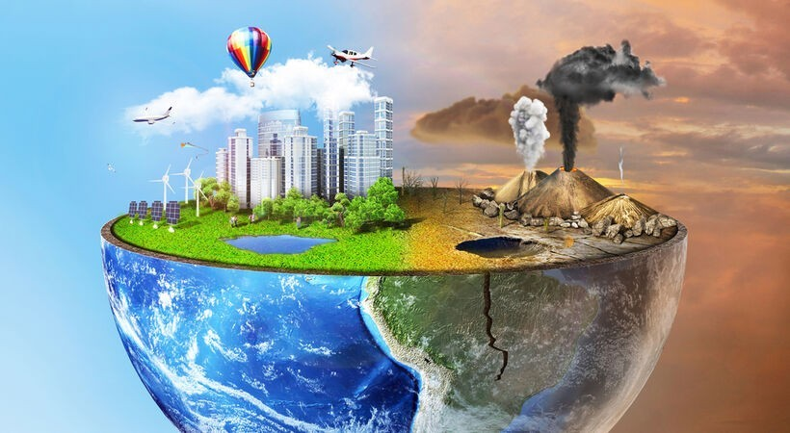
ENVIRONMENT POLLUTION

Slide 2
INTRODUCTION
Environment pollution is the contamination of the environment by harmful materials that negatively impact the environment`s normal processes. Such as air, water and land. It can be caused by factories, cars and how trash is thrown away. Pollution can have serious consequences including damaging ecosystems and human societies.

Slide 3
Types of pollution:
There are different types of pollution
The first to be studied were those in which pollutants had physical elemants: air pollution, water pollution and land pollution.
Later by analogy ,definitions were provided for noise pollution, light pollution, thermal pollution and electromagnetic pollution etc.

Slide 4
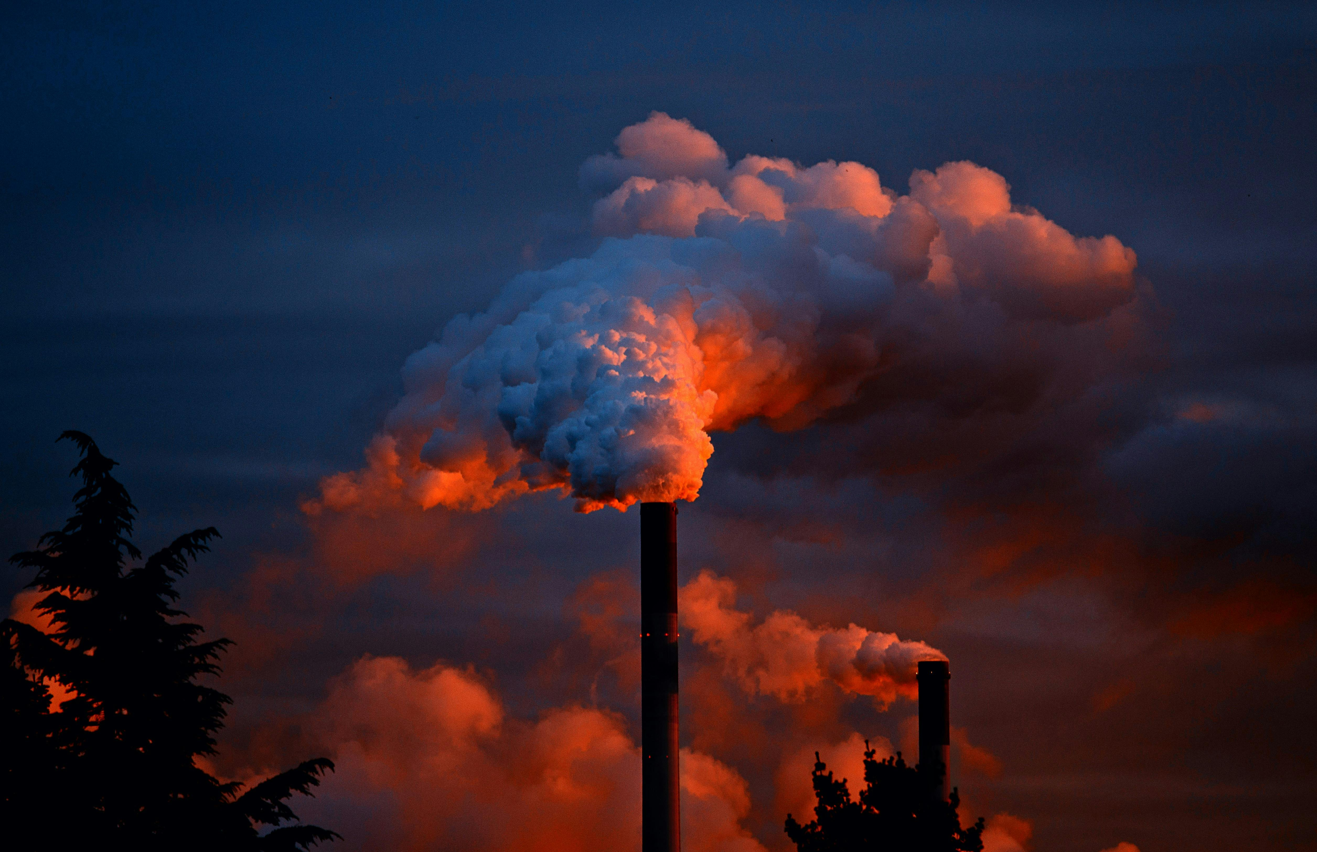
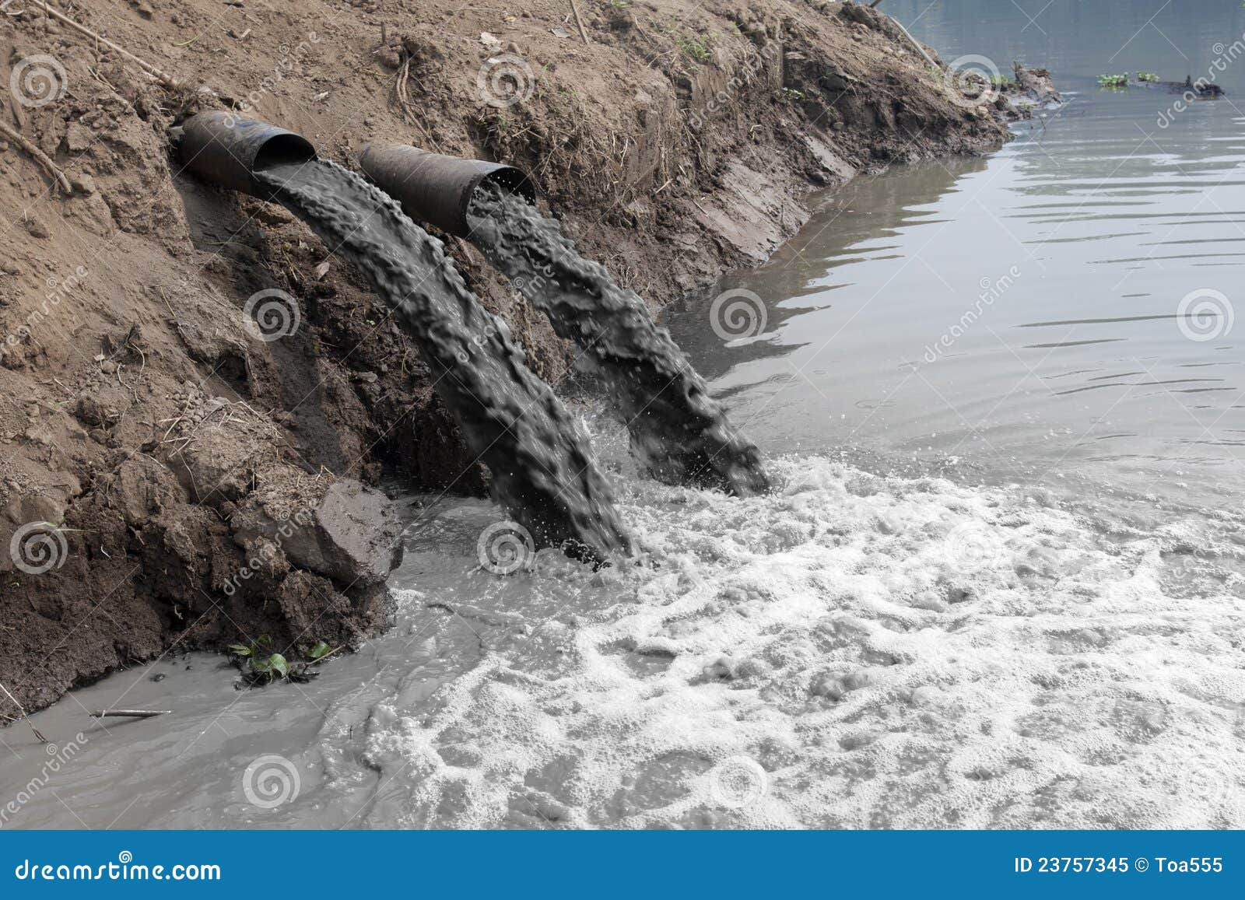
Air pollution& Water pollution:
Air pollution:
Air is the most prominent case. The most
visible phenomenon is smog(a portmanteau word combination of “smoke” and” fog”)formed by gases.
Water pollution: water pollution now affects virtually all the world`s seas, oceans, lakes and rivers. In the sea the most egregious cases are oil spills from shipping disasters.

Slide 5
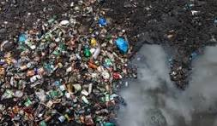
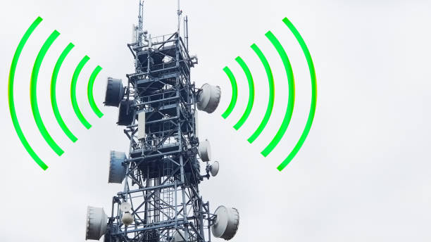
Soil & Electromagnetic pollution:
Soil pollution: Pollution along with erosion ,is now the main threat to soil on our planet and it has now reached every corner of the world. Soil pollution is caused both by macroscopic objects such as waste left by humans and by substances.
Electromagnetic pollution: Electromagnetic fields are often of natural origin for example: the earth magnetic fields or the electric fields generated by lightening. Sometimes ,electromagnetic pollution is contaminated by people.

Slide 6
Effect and reducing of pollution:
The effect of environmental pollution:
Environment pollution has a harmful effect on human health. According to World Health(WHO) estimates air pollution is responsible for 7 million premature deaths a year due to respiratory, cardiovascular and immune system ailments.
Reducing pollution: There are many things we can do to reduce our impact on the environment. If we use energy, transport and other goods and services more carefully , we can reduce harmful emissions to our air , land and water .Everyday choices have the power to make a difference and help protect our environment for a clean and sustainable future.

Slide 7
Thank you so much

